Slide 1
Live demo - Building a Pasoe Docker image in a pipeline
Daniël van Doorn
Senior DevOps Consultant

Slide 2
Agenda
About us
Live Demo
Plan
Used Tool Stack
Out of Scope
Workspace Setup

Slide 3
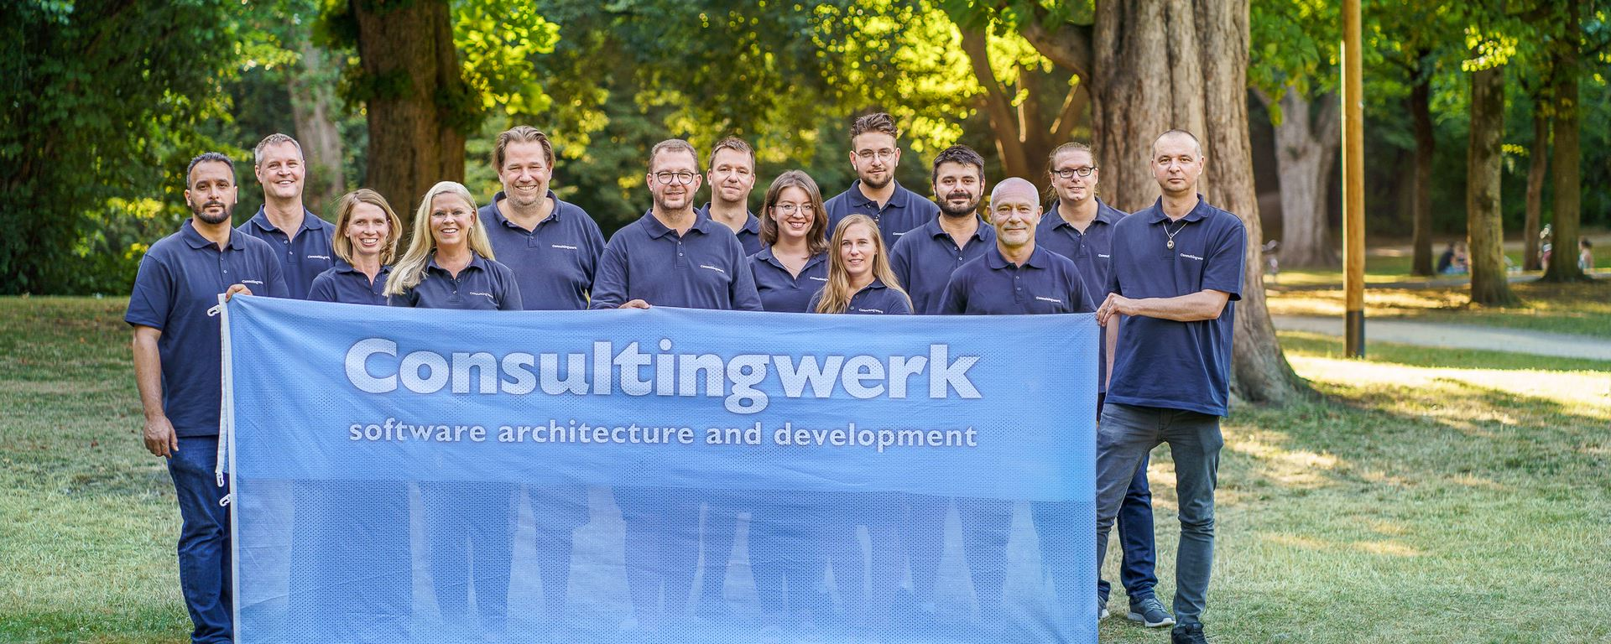

Slide 4
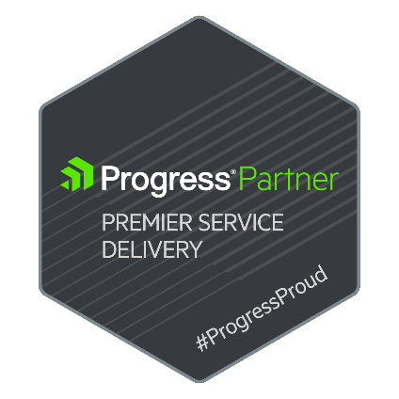
Consultingwerk Software Services Ltd.
Independent IT consulting organization
Focusing on OpenEdge and related technology
Located in Cologne, Germany, subsidiaries in UK, USA and Romania
Customers in Europe, North America, Australia and South Africa
Vendor of developer tools and consulting services
Specialized in GUI for .NET, Angular, OO, Software Architecture, Application Integration
Experts in OpenEdge Application Modernization

Slide 5
Services Portfolio, Progress Software
OpenEdge (ABL, Developer Tools, Database, PASOE, …)
Telerik DevCraft (.NET, Kendo UI, Angular, …), Telerik Reporting
OpenEdge UltraControls (Infragistics .NET)
Telerik Sitefinity CMS (incl. integration with OpenEdge applications)
Kinvey Plattform, NativeScript
Corticon BRMS
WhatsUp Gold infrastructure-, network- and application monitoring
Kemp Loadmaster
…

Slide 6
Services Portfolio, related products
Protop Database Monitoring
Combit List & Label
Web frameworks, e.g. Angular
.NET
Java
ElasticSearch, Lucene
Amazon AWS, Azure
DevOps, Docker, Jenkins, ANT, Gradle, JIRA, …
…

Slide 7
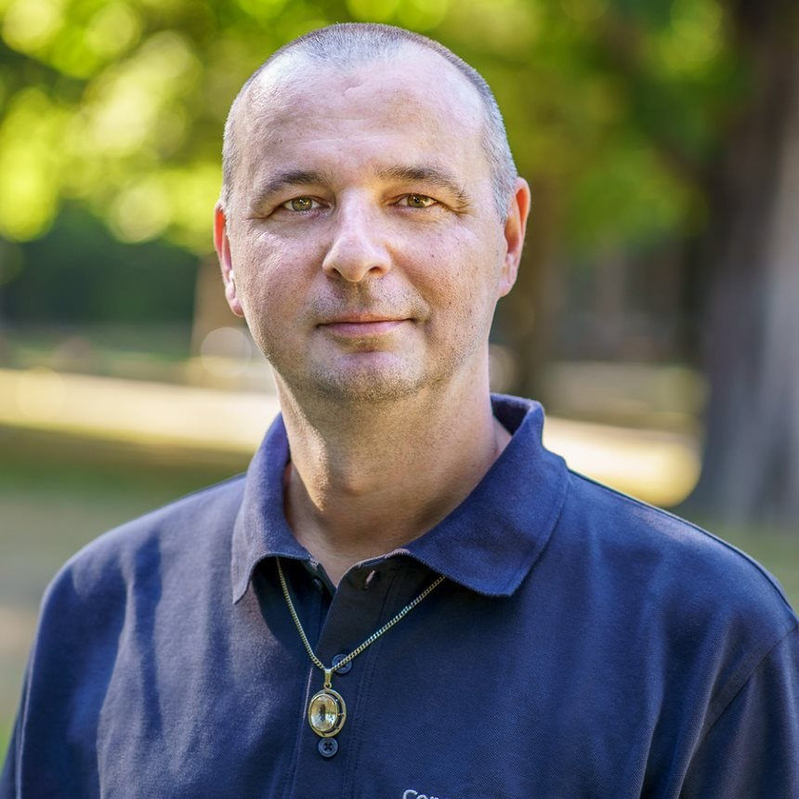
Daniel van Doorn
Senior Consultant
Started developing Progress in 1997 with version 7.
DevOps
Build & Deployment of OpenEdge applications

Slide 8
Building the Docker image: Tool Stack
Gogs (Go Git Server + Postgresql DB for Git)
Git
Jenkins and Git plugin
Ant & PCT (From the DLC)
Docker desktop
WSL2 + Ubuntu
OpenEdge and OpenEdge PASOE Docker image (12.7.0)
Java (17.0.4)
Visual Studio Code

Slide 9
Building the Docker image: Out of Scope
PASOE security / authentication
Database connections
Database containers
Command Line configuration:
tcman feature <like enable/disable HTTP>
Secprop for updating oeablSecurity.properties
Scripts to make this demo easier (will be viewed)

Slide 10
Building the Docker image: The plan
Source
Compile
Create Library
Prep Docker workspace
Build Docker Image
Build Docker Image
Base Image
Add Java
Add Entrypoint script
Create PASOE
Add Application pl
Configure PASOE

Slide 11
Live Demo
Building an REST API inside a Docker container
Setting up Jenkins (only master no additional build nodes)
Set up a multi branch pipeline with Jenkinsfile
Building / Compiling the API
Assembling the Docker Work Space
Creating the Docker image
Configuring the PASOE in the Dockerfile
Running the Docker container

Slide 12
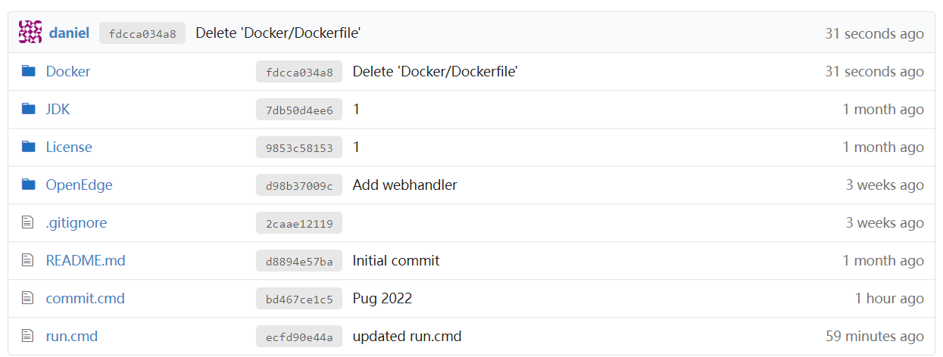
Git workspace

Slide 13
Out of scope for the demo Already provided in the workspace

Slide 14
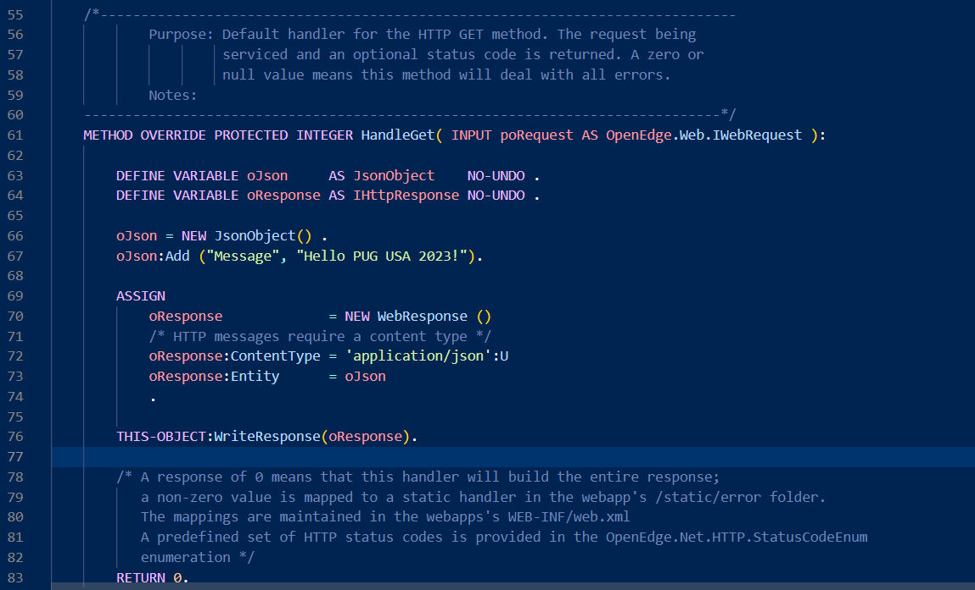
The API

Slide 15
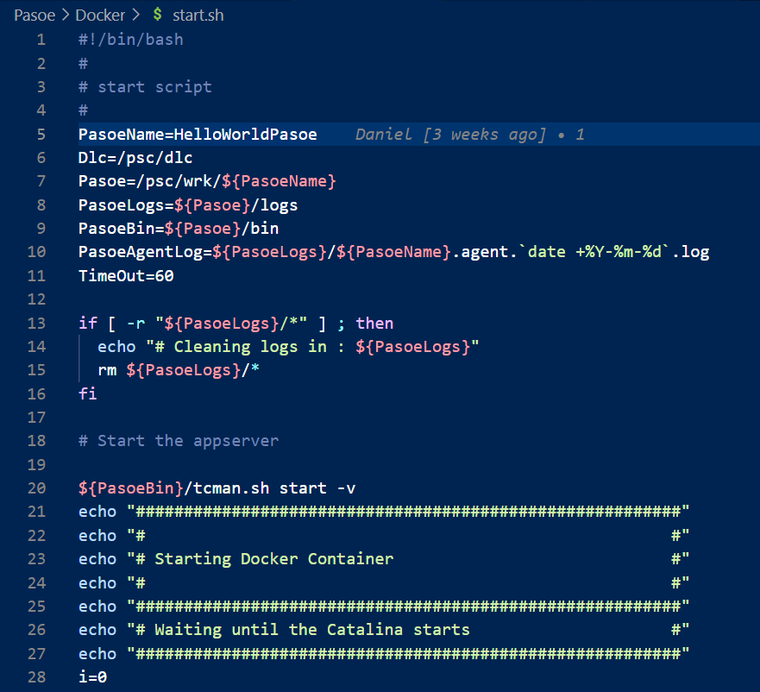
Entry Point Script

Slide 16
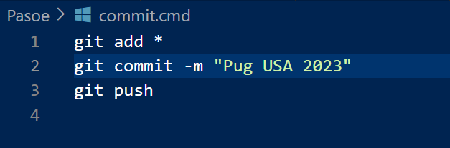
commit.cmd

Slide 17
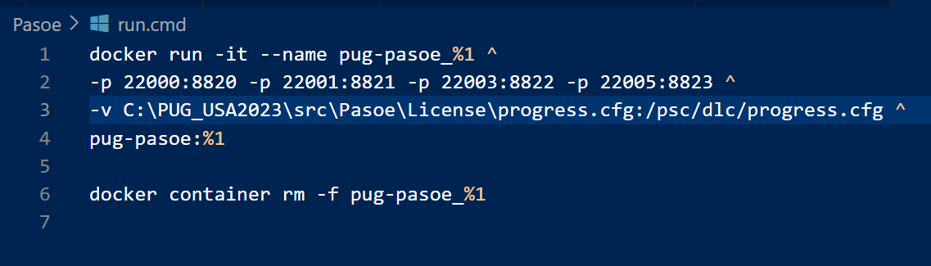
run.cmd

Slide 18
Requirements for PASOE Docker image
From PASOE base image (12.7.0)
Install JDK (JDK 17.0.4)
Insert entry point script start.sh (remove CTRL-M and make executable)
Create PASOE instance
Insert the Progress Library into the PASOE
Update openedge.properties
Configure entry point script and expose the ports

Slide 19
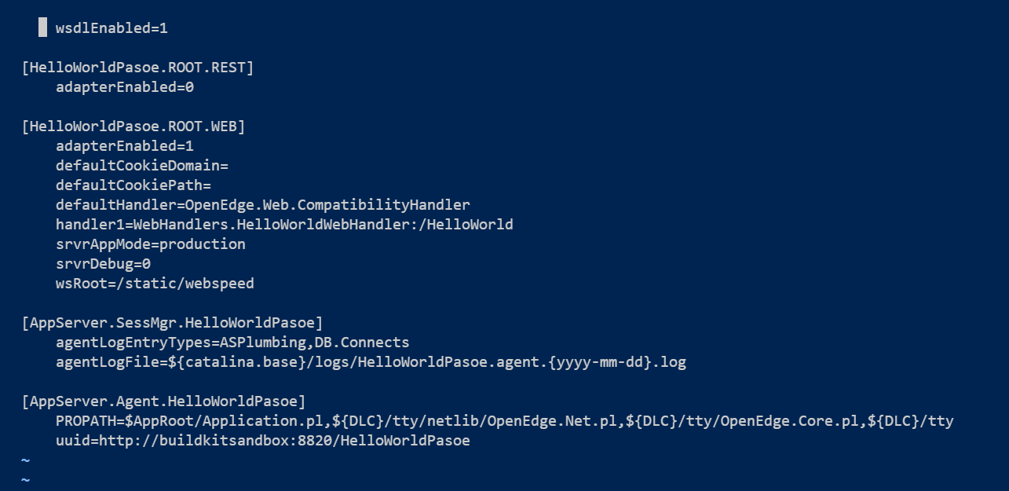
The PASOE specific configuration

Slide 20
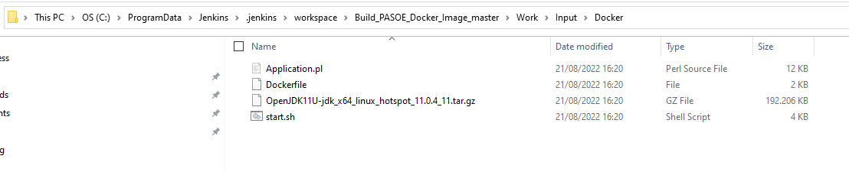
Target Docker Workspace

Slide 21
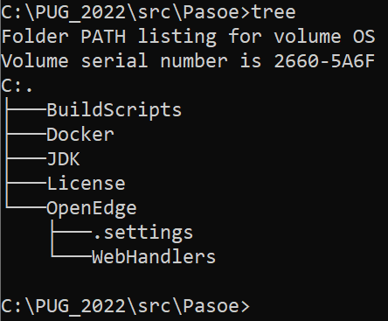
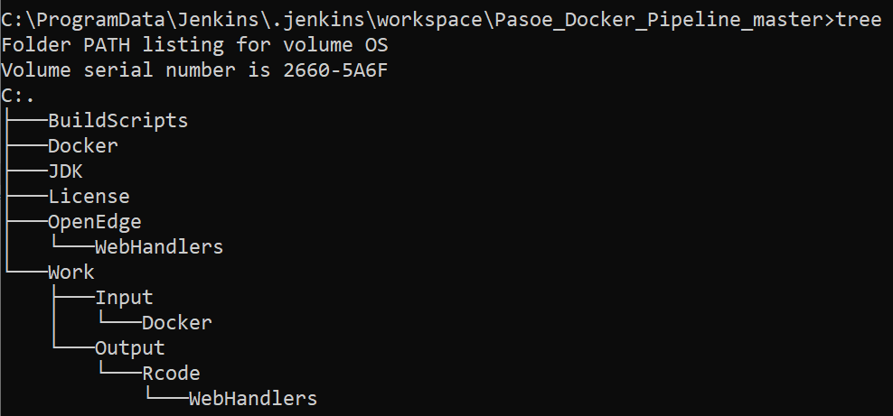
Work spaces
Git workspace
Jenkins Build workspace

Slide 22
In scope for the live coding demo:
Jenkinsfile for multi-branch pipeline
Build.xml an Ant build script to compile, create the library and prepare the Docker workspace
Dockerfile to build the Docker image

Slide 23


Slide 24


PUG Challenge Americas is coming back!
November 13 – 15, 2023 (Monday to Wednesday)
Burlington, MA
OpenEdge focused, purely technical content, 50+ break-out sessions

Slide 25
Previous / recorded Webinars
July 20th – Using .NET core with OpenEdge, Mike Fechner
June 8th : Office 365 authentication for OpenEdge GUI applications
May 18th : ABL Logging: From Files to the Cloud, with No Code Changes
April 20th : What is my AppServer doing all day long?
March 29th : Mysteries of ProDataset and Temp-Table parameters
…
https://www.consultingwerk.com/news/events
https://www.youtube.com/@consultingwerk

Slide 26
Next Webinars
We will continue this webinar series after PUG Challenge Europe, OpenEdge world-tour in Las Vegas and PUG Challenge Americas
…
https://www.consultingwerk.com/news/events

Slide 27

Questions

